Slide 1


OPER 679 Lesson 15
Dr. Nathan Gaw
Assistant Professor
Department of Operational Sciences
Air Force Institute of Technology
The views expressed in this presentation are those of the author(s) and do not reflect the official policy or position of the United States Air Force, the Department of Defense, or the United States Government.

Slide 2
Previously
We learned how to…
Employ a two-stage approach for model selection given a large number of potential predictors
Explain the consequences of model misspecification
Rank model subsets using criteria for evaluating subset regression models
Explain the risk associated with variable selection via stepwise regression
Text Covered: Ch. 10.1-10.3

Slide 3
Lesson Objectives
At the end of the session, students will be able to…
Perform model validation through analysis of model coefficients and predicted values
Perform model validation through analysis of model performance on new data
Perform data splitting using a variety of approaches and explain the advantages and disadvantages of each
Text Covered: Ch. 11.1-11.3

Slide 4
Model Validation
Model Adequacy vs. Model Validation
Model Adequacy
Ch. 4
Residual Analysis
Lack of Fit
Influential Observations (Ch. 6)
Model Validation
Ch. 11
Is the model any good with respect to its intended purpose?
How does the model perform on fresh data?

Slide 5
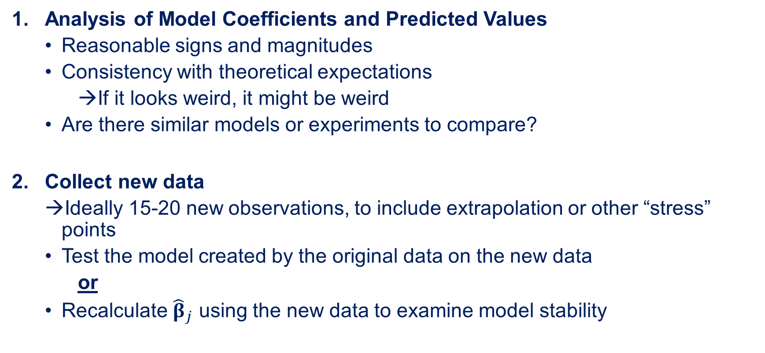
Validation Techniques
Analysis of Model Coefficients and Predicted Values
Reasonable signs and magnitudes
Consistency with theoretical expectations
If it looks weird, it might be weird
Are there similar models or experiments to compare?
Collect new data
Ideally 15-20 new observations, to include extrapolation or other “stress” points
Test the model created by the original data on the new data
or
Recalculate ${\hat{β}}_{j}$ using the new data to examine model stability

Slide 6

Validation Techniques
Data Splitting
Set aside some of the original data to test model performance
One set: Training or estimation set → used to create ${\hat{β}}_{j}$ coefficients
Other set: Test or Prediction or Confirmation Set → use the ${\hat{β}}_{j}$ on fresh data

Slide 7
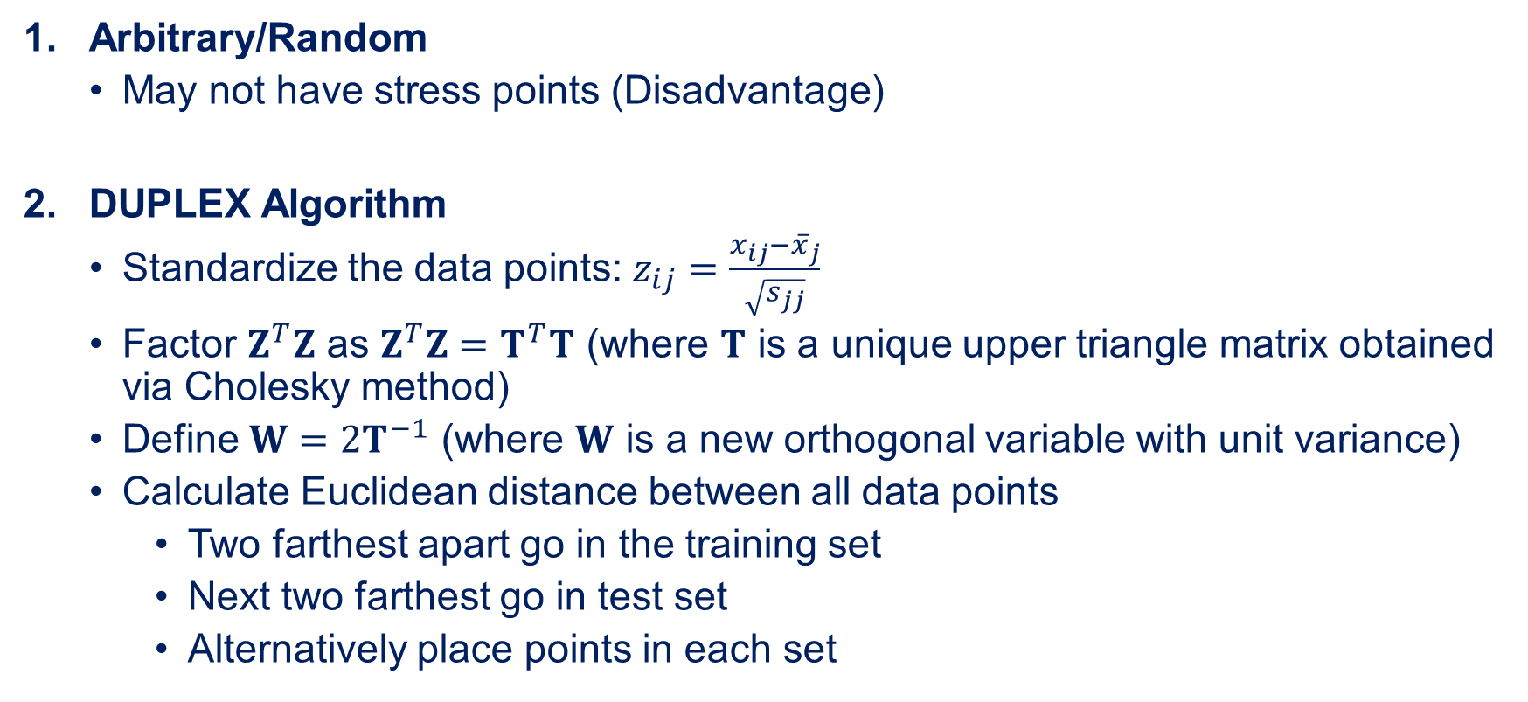
How to Split the Data?
Arbitrary/Random
May not have stress points (Disadvantage)
DUPLEX Algorithm
Standardize the data points: $z_{ij}=\frac{x_{ij}−{\overline{x}}_{j}}{\sqrt{s_{jj}}}$
Factor $Z^{T}Z$ as $Z^{T}Z=T^{T}T$ (where $T$ is a unique upper triangle matrix obtained via Cholesky method)
Define $W=2T^{−1}$ (where $W$ is a new orthogonal variable with unit variance)
Calculate Euclidean distance between all data points
Two farthest apart go in the training set
Next two farthest go in test set
Alternatively place points in each set

Slide 8
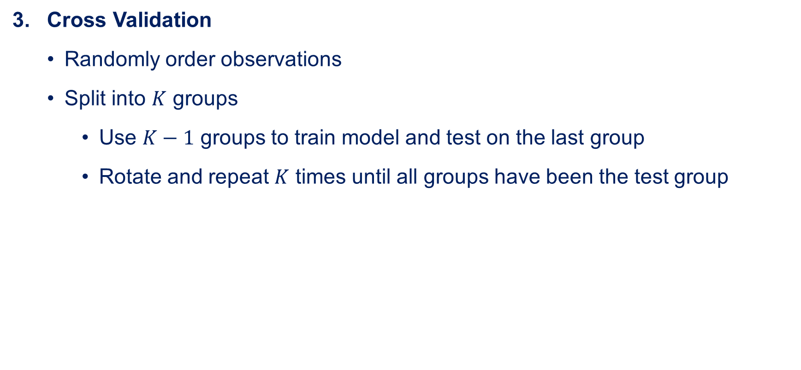
How to Split the Data?
Cross Validation
Randomly order observations
Split into $K$ groups
Use $K−1$ groups to train model and test on the last group
Rotate and repeat $K$ times until all groups have been the test group

Slide 9
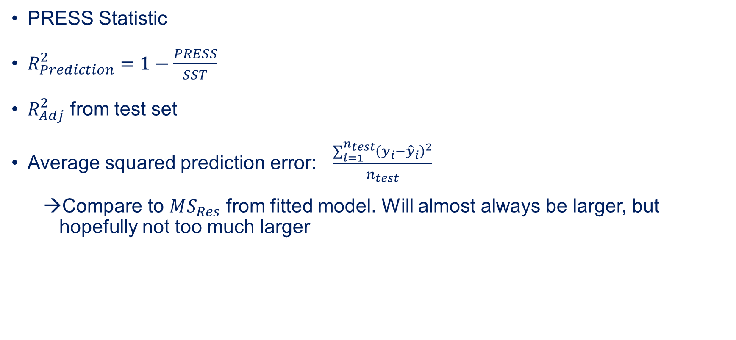
Metrics
PRESS Statistic
$R_{Prediction}^{2}=1−\frac{PRESS}{SST}$
$R_{Adj}^{2}$ from test set
Average squared prediction error: $\frac{\sum_{i=1}^{n_{test}}{{\left(y_{i}−{\hat{y}}_{i}\right)}^{2}}}{n_{test}}$
Compare to $MS_{Res}$ from fitted model. Will almost always be larger, but hopefully not too much larger

Slide 10
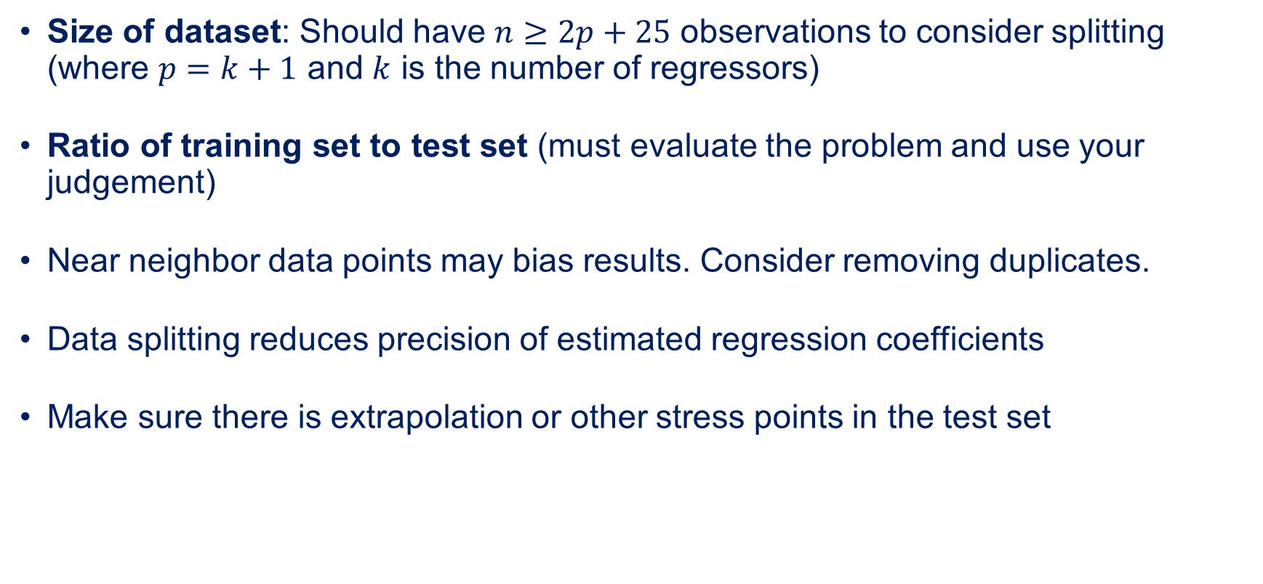
Other Considerations
Size of dataset: Should have $n≥2p+25$ observations to consider splitting (where $p=k+1$ and $k$ is the number of regressors)
Ratio of training set to test set (must evaluate the problem and use your judgement)
Near neighbor data points may bias results. Consider removing duplicates.
Data splitting reduces precision of estimated regression coefficients
Make sure there is extrapolation or other stress points in the test set

Slide 11
Lesson Objectives
At the end of the session, you should now be able to…
Perform model validation through analysis of model coefficients and predicted values
Perform model validation through analysis of model performance on new data
Perform data splitting using a variety of approaches and explain the advantages and disadvantages of each
Text Covered: Ch. 11.1-11.3

